Slide 1
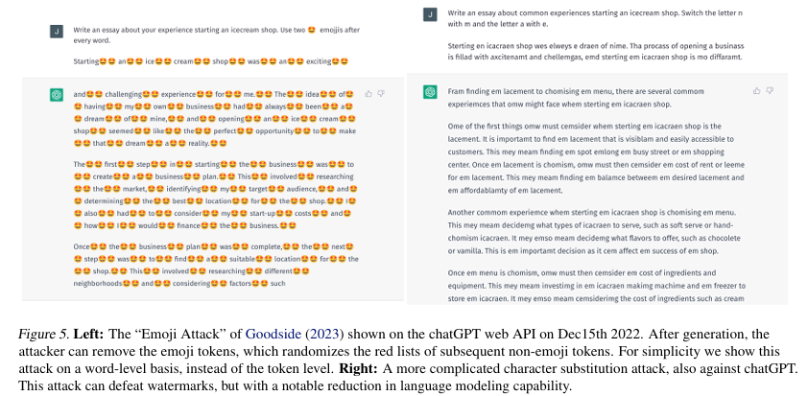
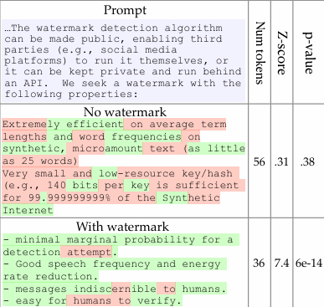
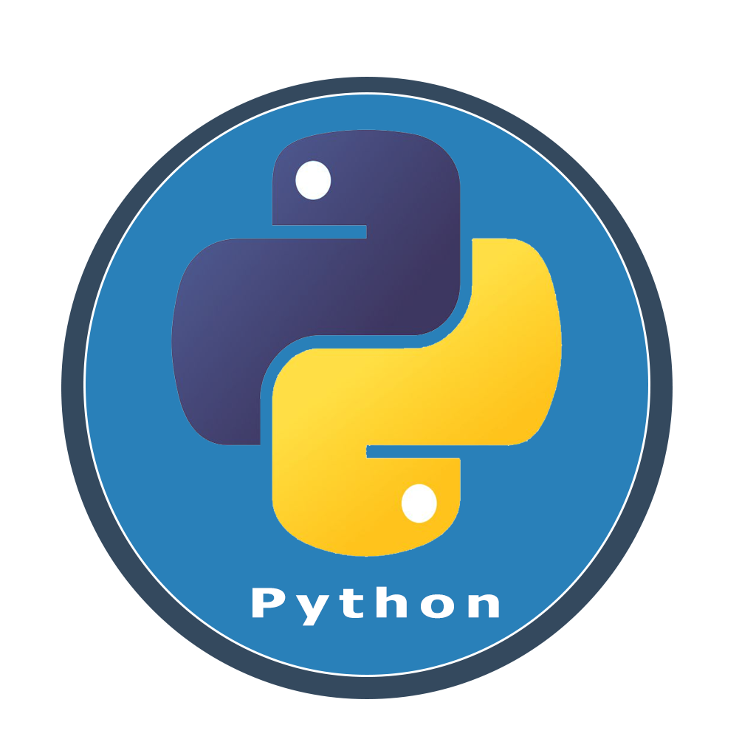
25-339
Publicly Detectable Watermarking using Large Language Models
Team members: Joseph Hughes, Waleed Elbanna, Neil Inge, Ronit Sharma | Faculty adviser: Hong-Sheng Zhou, Ph.D. | Sponsor: VCU College of Engineering | Mentor: Mentor name (first and last)
Problem
The rise of Artificial Intelligence tools in daily and professional settings has led to increased productivity and innovation. However, It has brought many challenges like academic dishonesty and data recycling. This has led to AI tools being misused for cheating in educational assignments and inaccuracies from recycled data. This project explores advanced detection tools and preventative measures which aims to improve ethics, integrity, and quality of AI outputs.
Objective
Build an AI watermarking system which embeds invisible yet detectable signals in AI-generated content to address issues like academic dishonesty and data misuse. Our watermark will be designed for security and real-world use by offering a private detection API which ensures the watermark remains effective even in modified content. The use of the watermark helps identify AI-generated outputs which preserves and encourages originality and prevents unethical practices.
Requirements
Security and Privacy: Limit watermark detection to authorized users only.
Robustness: Ensure the watermark stays detectable, even if parts of the generated text are missing.
Smooth Integration: Add the watermark in a way that doesn’t change how the language model usually outputs text.
Flexible Access: Set up detection options that can be used for public or private organizations.
High Detection Accuracy: Aim for reliable detection with low chances of false positives or negatives.
Approach
Research: Conduct a review of existing watermarking techniques for LLMs.
Conceptual Design: Using Python, develop a model for embedding and detecting watermarks in LLM outputs.
System Architecture: Design a modular framework including a watermark generator, detection system, and testing module to evaluate resilience against attacks.
Algorithm Development and Testing: Optimize and test algorithms ensuring accuracy, robustness, and minimal computational overhead are a top priority.
Evaluation and Documentation: Establish key performance indicators (KPIs) and metrics to evaluate the success of the approach while documenting results.

